Slide 1
Weka & Rapid Miner Tutorial
By
Chibuike Muoh

Slide 2
WEKA:: Introduction
A collection of open source ML algorithms
  pre-processing
  classifiers
  clustering
  association rule
Created by researchers at the University of Waikato in New Zealand
Java based
Notes:
Talk about
* hacking weka
* discretization
* cross validations

Slide 3
WEKA:: Installation
Download software from http://www.cs.waikato.ac.nz/ml/weka/
  If you are interested in modifying/extending weka there is a developer version that includes the source code
Set the weka environment variable for java
  setenv WEKAHOME /usr/local/weka/weka-3-0-2
  setenv CLASSPATH $WEKAHOME/weka.jar:$CLASSPATH
Download some ML data from http://mlearn.ics.uci.edu/MLRepository.html

Slide 4
WEKA:: Introduction .contd
Routines are implemented as classes and logically arranged in packages
Comes with an extensive GUI interface
  Weka routines can be used stand alone via the command line
    Eg. java weka.classifiers.j48.J48 -t $WEKAHOME/data/iris.arff

Slide 5
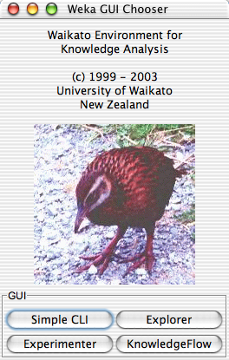
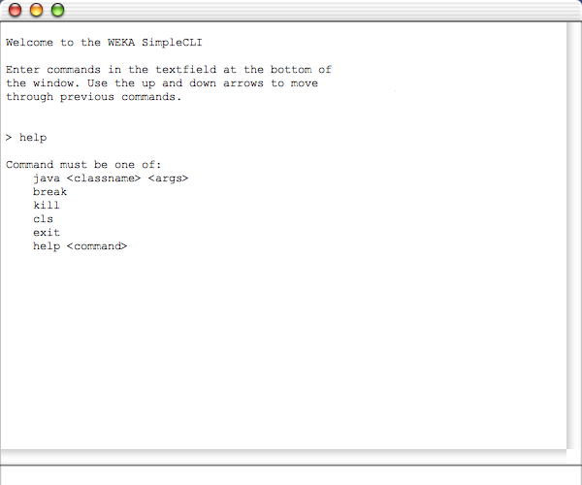
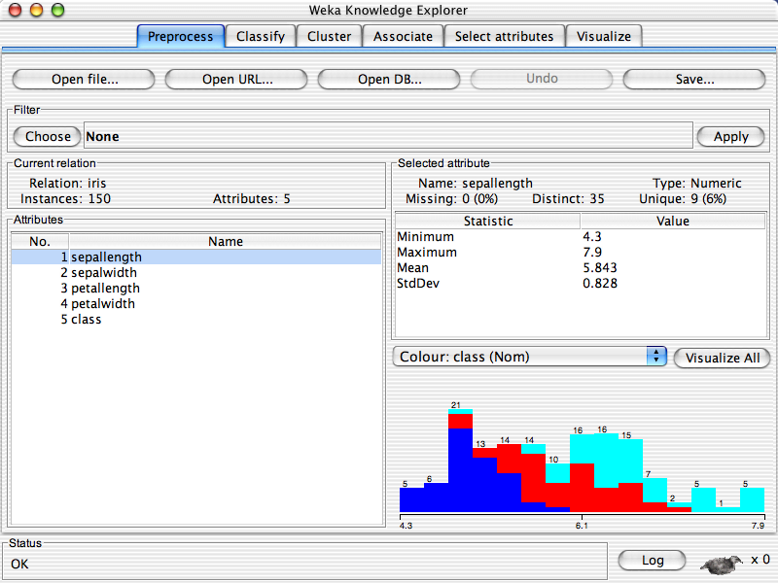
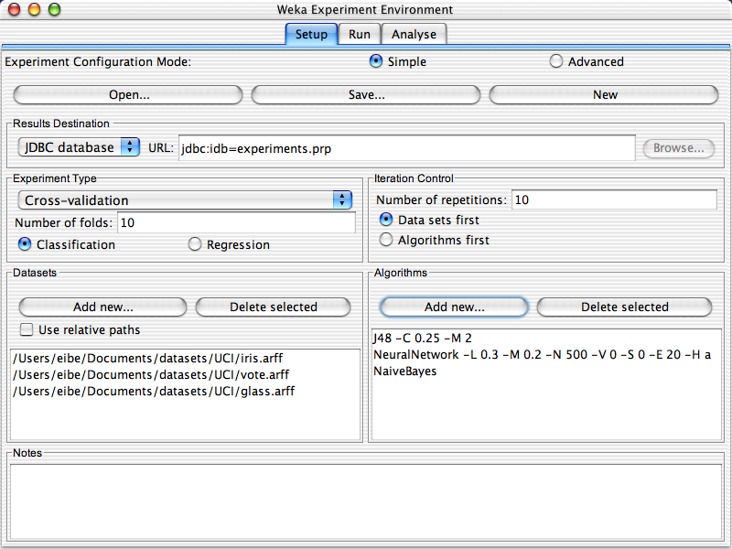
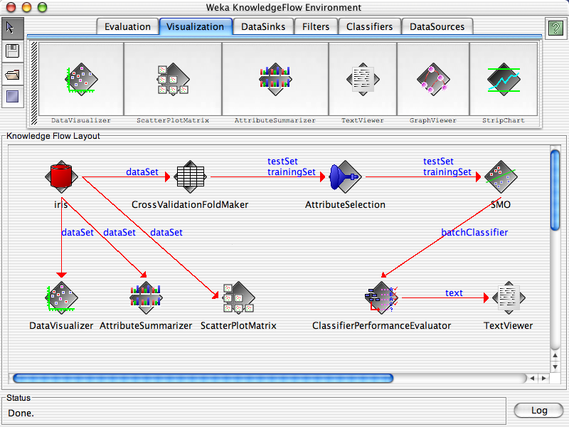
WEKA:: Interface
Notes:
Simple CLI provides a commandline interface to weka’s routines
Explorer interface provides a graphical front end to weka’s routines and components
Experimenter allows you to build classification experiments
KnowledgeFlow provides an alternative to the Explorer as a graphical front end to Weka's core algorithms.

Slide 6
WEKA:: Data format
Uses flat text files to describe the data
Can work with a wide variety of data files including its own “.arff” format and C4.5 file formats
Data can be imported from a file in various formats:
  ARFF, CSV, C4.5, binary
Data can also be read from a URL or from an SQL database (using JDBC)

Slide 7
WEKA:: ARRF file format
@relation heart-disease-simplified
@attribute age numeric
@attribute sex { female, male}
@attribute chest_pain_type { typ_angina, asympt, non_anginal, atyp_angina}
@attribute cholesterol numeric
@attribute exercise_induced_angina { no, yes}
@attribute class { present, not_present}
@data
63,male,typ_angina,233,no,not_present
67,male,asympt,286,yes,present
67,male,asympt,229,yes,present
38,female,non_anginal,?,no,not_present
...
numeric attribute
nominal attribute
A more thorough description is available here http://www.cs.waikato.ac.nz/~ml/weka/arff.html

Slide 8
WEKA:: Explorer: Preprocessing
Pre-processing tools in WEKA are called “filters”
WEKA contains filters for:
  Discretization, normalization, resampling, attribute selection, transforming, combining attributes, etc

Slide 10
WEKA:: Explorer: building “classifiers”
Classifiers in WEKA are models for predicting nominal or numeric quantities
Implemented learning schemes include:
  Decision trees and lists, instance-based classifiers, support vector machines, multi-layer perceptrons, logistic regression, Bayes’ nets, …
“Meta”-classifiers include:
  Bagging, boosting, stacking, error-correcting output codes, locally weighted learning, …

Slide 11
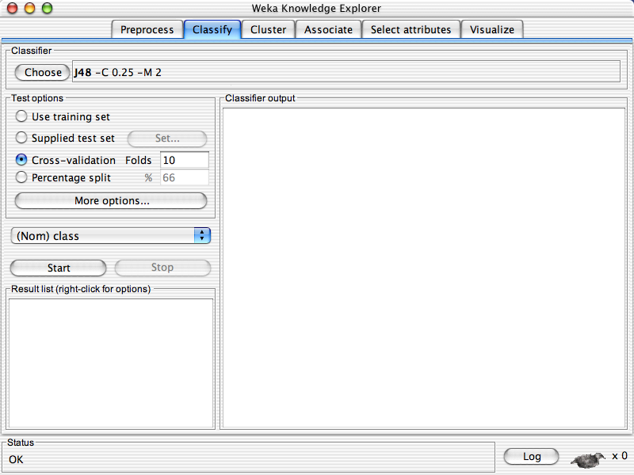
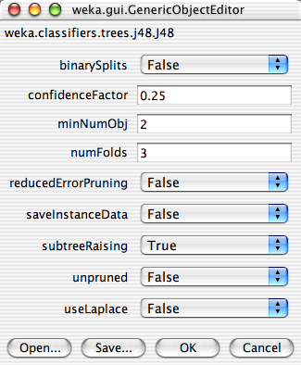

Slide 12
WEKA:: Explorer: Clustering
Example showing simple K-means on the Iris dataset

Slide 13
RapidMiner:: Introduction
A very comprehensive open-source software implementing tools for
  intelligent data analysis, data mining, knowledge discovery, machine learning, predictive analytics, forecasting, and analytics in business intelligence (BI).
Is implemented in Java and available under GPL among other licenses
Available from http://rapid-i.com

Slide 14
RapidMiner:: Intro. Contd.
Is similar in spirit to Weka’s Knowledge flow
Data mining processes/routines are views as sequential operators
  Knowledge discovery process are modeled as operator chains/trees
    Operators define their expected inputs and delivered outputs as well as their parameters
Has over 400 data mining operators

Slide 15
RapidMiner:: Intro. Contd.
Uses XML for describing operator trees in the KD process
Alternatively can be started through the command line and passed the XML process file

